Slide 1
Sugon ParaStor Cloud Storage System
Storage Product Division
May 2016
Notes:
事业部- Business Division?

Slide 2
Catalog
1
Market Positions
2
Product Specifications
3
Product Features
4
Application Scenarios
5
Classic Cases
Notes:
目录 改不了英文

Slide 3
Development Trends of Storage Market
Changes in Storage Market
  In 2015, the global storage market showed slow growth（2.2%）
  In 2015, the growth rate in Mainland China is 14.8%, 7.8% of the global market share
State owned manufacturers market grew by 43.3%, with current market share of 56.9%
Cluster NAS market continued to thrive
    Global market Scale-out NAS maintained steady growth (19.9%)
China market Scale-out cluster architecture storage market share reached 45.8%

Slide 4
Common Distributed File System
*
Commercial Systems
Open Source Systems
N9000
Loongstor
MooseFS
FastDFS
BWStor
Parastor
HDFS
TFS
Ceph
Isilon
PanaFS
GPFS
Gluster
Stornext
SONAS
Lustre
MPFS

Slide 5
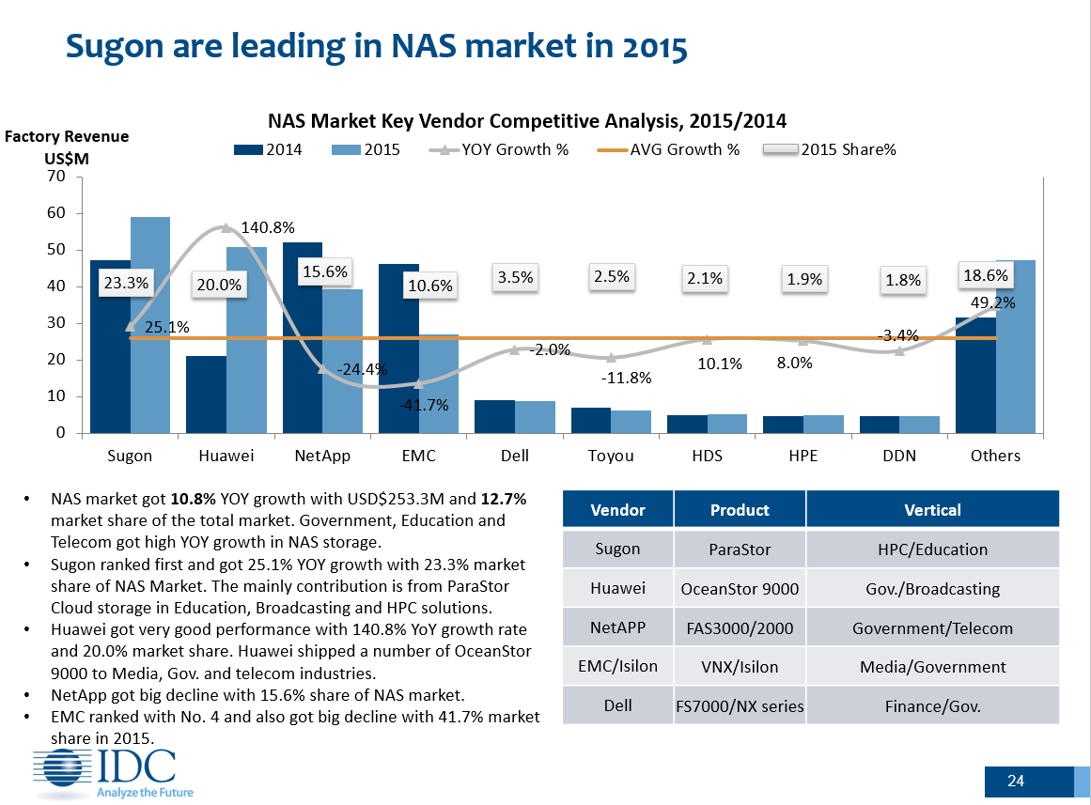
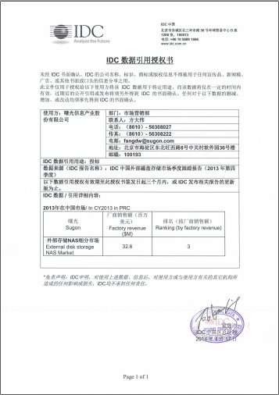
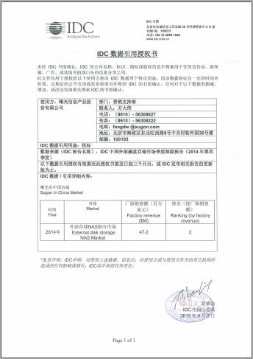
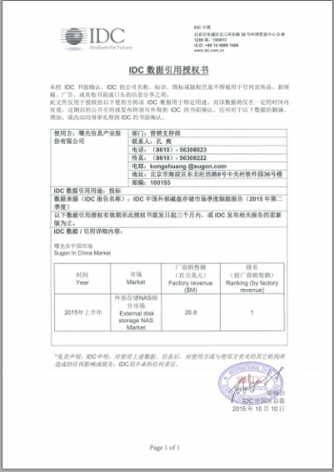
Market Position of ParaStor Storage System
1100+ successful user applications, 260+PB
cumulative sales volume
by 2015
Ranked 1st place
in China NAS IDC in 2013
Ranked 2nd in China NAS IDC in 2013
Ranked 3rd in China NAS IDC in 2013
Single system 16PB in 2010

Slide 6
Catalog
1
Market Positions
2
Product Specifications
3
Product Features
4
Application Scenarios
5
Classic Cases

Slide 7
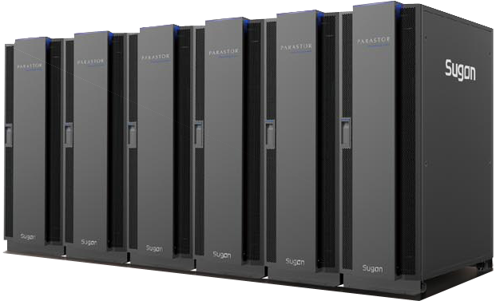
Product Specifications
Mass Unstructured Data Cloud Storage System– ParaStor
Distributed Storage Architecture
Scale-Out Cluster NAS Format
Massive Space, Elastic Expansion
Construct EB-Class Single Storage Space
Unstructured Data Storage
Performance
Reliability
Management
Complete Independent Development
No.1
Ranked first in IDC China NAS market
TOP3
Top 3 in IDC China NAS market in the last 4 consecutive year
No.1
Largest validated EB-class storage system in China
Notes:
完全自主研发

Slide 8






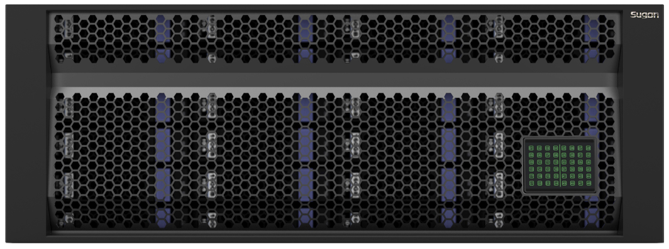
Logical Framework
Application
Protocol
POSIX
NFS
CIFS
FTP
HTTP
HDFS
ParaStor Distributed File System
Data
Processing
Protocol Engine
Advanced Storage Function
WebUI Management
Data Management
Data Protection
Hardware
Node
Management Node
Index Node
Data Node

Slide 9




System Architecture
Windows
UNIX/LINUX
Client
MAC
Metadata Read-Write
Concurrent Read-Write
Concurrent Read-Write
Concurrent Read-Write
Index Controller
Index Controller
……
Index Controller
Data Controller
Data Controller
Data Controller
Index Controller
Management Controller
Management Controller
Data
Transfer
Data
Transfer
Management Network
Data Controller
Data Controller
……
Data Controller
Data Archiving
Notes:
并发读写
索引控制器，数据控制器

Slide 10


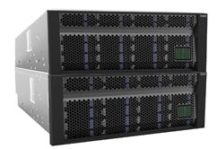
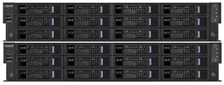
Product Form
ParaStor Cloud Storage System
2U24Bay
4U36Bay
With general product form, index controller supports 2~128, data controller supports 3~4096
Data controller supports 2U24, 4U24, 4U36, 5U86
Index controller uses reliable active-active architecture; data redundancy supports multiple copies and erasure code
4U24Bay
5U86Bay
ParaStor Binode System
Binode symmetric storage architecture, does not support expansion
Hardware Specification supports 2U12, 4U36
2U12Bay
4U36Bay
ParaStor Data Archiving System
Integrated data archiving function files online system data to ParaStor offline storage system
Online system can be ParaStor or third party NAS storage device
Notes:
数据归档系统

Slide 11
ParaStor Cloud Storage System
  24 2.5-inch SAS/SSD
  2U space
  Suitable for high IOPS scenarios
  24 hot swap hard disks
  1T/2T/3T/4T/6T SATA/NL-SAS HDD
  2.5inch10K SAS HDD/SSD
Data Node
2U24
4U24
High Performance
Large Capacity
  24 hot swap hard disks
  1T/2T/3T/4T/6T SATA/NL-SAS HDD
  2.5inch10K SAS HDD/SSD
  80 3.5-inch+6 2.5-inch hot swap hard disks
  Single node maximum 480TB (not including 6 2.5inch hard disks)
  Massive Near/Offline storage system
4U36
5U86
Large Capacity
High Density
Single node memory can expand up to 1.5TB
Network interface supports 1GbE、10GbE、40Gb/56Gb/100Gb Infiniband

Slide 12
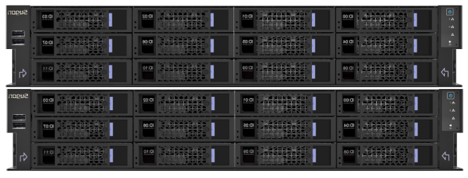
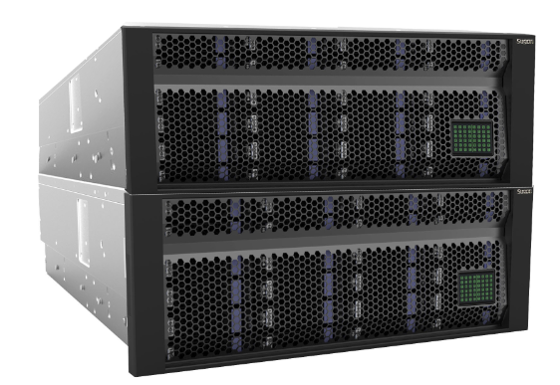
ParaStor Binode Storage System
Binode
Symmetric
Hardware
Specifications
Software
Features
  Binode Symmetrical Architecture
  2U12、4U36 plates
  Redundant architecture, no single point of failure
  2U12 contains 8 data disks
  4U36 contains 24 data disks
  Does not support node expansion
  Built-in ParaStor component and software
  POSIX/NFS/CIFS/FTP interface
  RESTful interface
  Double memory copy(recommanded) , 2+2:1
  Access management, quota, WORM
Suitable for Small Storage, large file storage scenarios
Suitable for markets for financial instruments, medical PACS, etc.
Not recommended for small file storage and requirement for expansions
Notes:
盘位, 数据盘

Slide 13
Catalog
1
Market Positions
2
Product Specifications
3
Product Features
4
Application Scenarios
5
Classic Cases

Slide 14
Product Features
High
Performance
High
Reliability
High
Expansibility
Multifunction
Easy
Management
Storage
Strategy
Industry
Optimization
Data
Protection
Single node/collective bandwidth
Small file aggregation
Linear increase
Redundant architecture
Multiple copy/ Erasure Code
Data quick fix
EB-class expandable
Online expansion
Metadata performance
Automatic data equalizing
Diverse provider
Abundant cluster NAS functions
Graphical user interface
Easy operation and maintenance
Disk packet
Node partition
Class-based Storage
Quota management
Catalog fragmentation
Remote Sync
Data archiving
Access Management
User Management
WORM
QoS
Automatic power consumption control
Thin provisioning
Unified monitoring management
In-time alerting

Slide 15
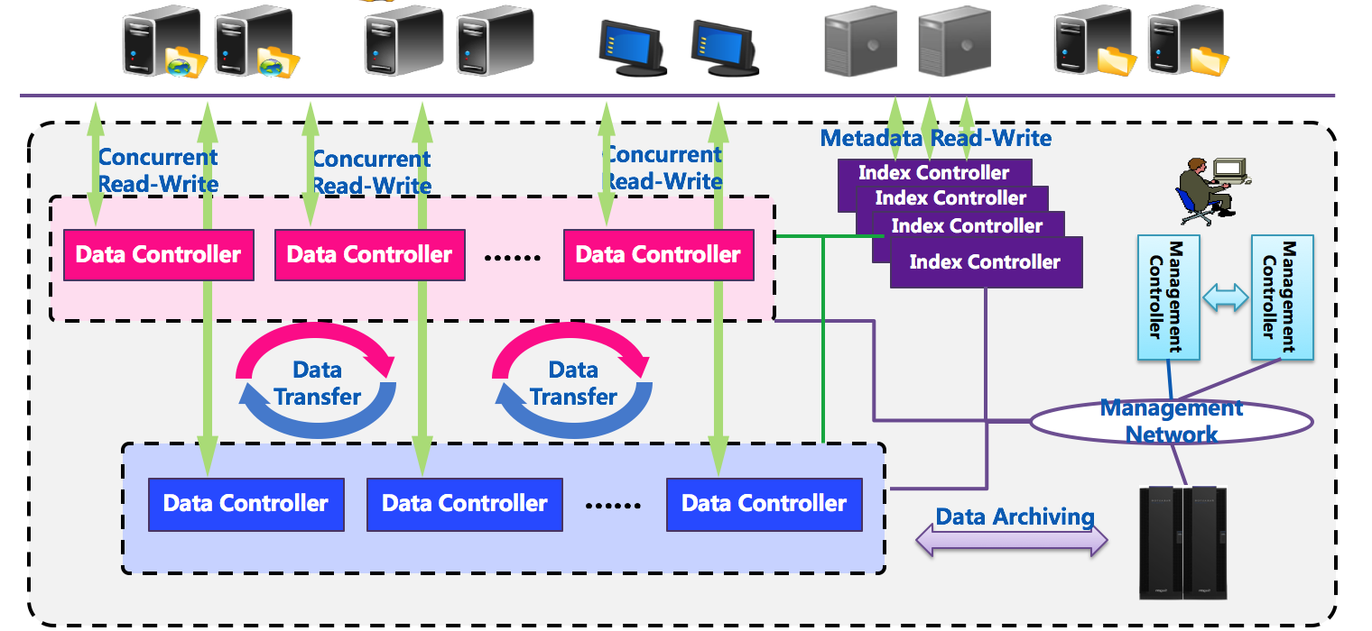
Outstanding Performance, Linear Growth
Parallel Cluster Architecture Design
Satisfies High Concurrency IOdemand
All Active Archive Cluster Improves Massive Small File Handling Power
Aggregate bandwidth is equal to the bandwidth of the data controller, increases linearly with the volume
Strip Optimization Provides High Single Stream IO Bandwidth
Notes:
线性增长？
聚合带宽等于数据控制器带宽线性叠加

Slide 16





Data Redundancy, Secure and Reliable
/home
/home/appl/data/web/important_big_spreadsheet.xls
/home/appl/data/web/important_big_spreadsheet.xls
/home/appl/data/web/important_big_spreadsheet.xls
/appl
/home/appl/data/web/big_architecture_drawing.ppt
Logic Layer
/home/appl/data/web/big_architecture_drawing.ppt
/data
/home/appl/data/web/unstructured_big_video.mpg
/web
/home/appl/data/web/unstructured_big_video.mpg
Traction Controller
Traction Controller
以太网交换机2
以太网交换机1
6
7
8
9
10
11
0
1
2
3
4
5
0
1
2
3
4
5
6
7
8
9
10
11
g
g
h
h
i
i
j
j
k
k
l
a
b
c
d
e
f
l
A
B
a
b
c
d
e
f
A
B
C
D
E
F
G
H
I
J
K
L
C
D
E
F
G
H
I
J
K
L
Physical Layer
0
1
2
A
B
C
Notes:
放动画

Slide 17
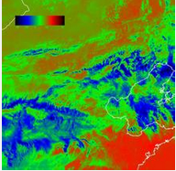


Data Redundancy Multiple Copies vs. Erasure Code
Node1
Node2
Node3
NodeN-1
NodeN
D
D
D
D
D
Data Segment Storage
D
D
D
D
D
Multiple Copies
N+M Erasure Code
D1
D11
D12
D1m
D1
D2
D3
Dn
D2
D21
D22
D2m
Erasure Code Algorithm
D3
D31
D32
D3m
Data
Replication
P1
P2
P3
Pm
Dn
D31
D32
D3m
Space Utilization：1/(1+M)
Space Utilization：N/(N+M)

Slide 18


Erasure Code Redundency N+M:b
Understanding of N+M
  N：Number of data object
  M：Number of Validation object
Understanding of b
  Number of failure node allowed
M：Number of failure disks allowed
4+2:1
N=4，M=2
Node1
Node2
Node3
D1
D2
D3
D4
P1
P2
D
D
D
P
P
D
D1
D2
D3
D4
P1
P2
4+2:2
Node1
Node2
Node3
Node4
Node5
Node6
D
D
D
D
P
P
D1
D2
D3
D4
P1
P2

Slide 19
Common N+M:b models
N+M：b | Minimum node number to meet data distribution | Minimum node number to meet data recovery | Space Utilization
4+2:1 | 3 | 4 | 66.7%
4+2:2 | 6 | 8 | 66.7%
8+2:1 | 5 | 6 | 80%
8+2:2 | 10 | 12 | 80%
10+2:1 | 6 | 7 | 83.3%
10+2:2 | 12 | 14 | 83.3%
16+1:1 | 17 | 18 | 94.1%
16+4:2 | 10 | 12 | 80%
16+4:4 | 20 | 24 | 80%
b(N+M)/M
[b(N+M)/M]+b

Slide 20


Node Partition
b has a maximum of 4, but when the scale of node is big, only 4 node failures are allowed?
Divide into multiple partitions, decrease node failure area
b：Number of failure nodes allowed in each partition
30 nodes，4+4：2
Area A : 16 nodes，Area B: 14Nodes
Redundancy：2 nodes（b=2）
Area A
01
02
03
04
05
06
07
08
09
10
11
12
13
14
15
16
17
18
19
20
Area B
21
22
23
24
25
26
27
28
29
30

Slide 21
Disk Stripping
M has a maximum of 4, when the number of disks is big, only 4 disk failures are allowed?
Strip into multiple areas, decrease disk failure area
M：Number of disk failures allowed in each part
Each part contains 50 disks
Divided into 4 disk groups，G1=G2=13，G3=G4=12
Redundancy：3 disks（M=3）
01
02
03
04
05
06
07
08
09
10
G1
11
12
13
14
15
16
17
18
19
20
G2
21
22
23
24
25
26
27
28
29
30
G3
Fail
31
32
33
34
35
36
37
38
39
40
41
42
43
44
45
46
47
48
49
50
G4
Fail

Slide 22


Massive Space, Elastic Expansion
LAN
Parallel Data I/O
Parallel Data I/O
Data Controller
Data Controller
Data Controller
Data Controller
Data Controller
Data Controller
1
2
1
2
1
2
After Expansion
3
4
3
4
3
4
Data Controller
Data Controller
Data Controller
1
2
1
2
1
2
Original State
3
4
3
4
3
4
Increase Data Controller
Strategically Transfer Data

Slide 23
Abundant Interface, Diverse Applications
NFS/CIFS Access Mode (Cluster NAS)
Provider
  Proprietary Linux，Windows kernel mode provider
  POSIX API
  NFS/CIFS/FTP interface
  RESTful interface
  HDFS interface
  SNMP interface
  Network Interface
  40/56/100Gb IB
  10Gb/1Gb Ethernet
  RDMA
  Support load balancing and redundancy
Application
Server
FTP Storage
Server
Windows
Server
● ● ●
Private Interface Application Mode (Parallel Storage)
Supporting Linux and Windows
NFS、CIFS、FTP、REST、HDFS……
Storage System Formation
Application
Node
Application
Node
I/O Node
I/O Node
I/O Node
Application
Node
● ● ●
VFS
VFS
VFS
WinFS
Storage System Formation
oApp
oApp
oApp
ParaStor File System

Slide 24


RESTful Interface
RESTful Interface
Key-Value access
PUT (write)
  Client side write operation
  After the file is written onto the storage, key is generated, sending back to the client
KEY
GET (Read)
  Client side read operation, sending key
  Storage side send the corresponding file (value) back to client
  Suitable Scenario
Write Once Read Many
Digital Media (Image, Audio), Scan Image, Law and referenced documents, Medical Image, Bank notes, etc.
Binode storage system is recommended for small scale CAS storage
RESTful Interface，HTTP Protocol Transfer
Data Node
Data Node
Data Node
Web Engine
Web Engine
Web Engine
Data Service
Data Service
● ● ●
Data Service

Slide 25
HDFS Interface
Behavior
Analysis
Public Opinion Analysis
Personalized Recommendation
Multi-Dimensional Display
Product Features
Data Access Interface（SQL++/JDBC/CLI）
Analysis Mining Library
ParaStor-Xdata integrated system
  Install Xdata softwares on ParaStor data nodes
  Separate deployment for Xdata node management
Sugon Big Data Platform
Management Software
Stream Processing Engine
Parallel Database Middleware
Batch Processing Engine
Memory Calculation Engine
Big Data Standard System
Big Data Security System
Relational Database
Distributed Cloud Storage(HDFS)
ParaStor Distributed File System
Advantages
Sugon ETL Toolset
Complete independent development, capable of deep application optimizations
ParaStor compared to open-source HDFS
  High space utilization, performance, redundancy
  Cost advantage of integrated system
Provide HFDS standardized interface
Potential for the underlying storage space for Hadoop big data analytic software
Seamless combination with Xdata products

Slide 26
Cluster NAS Access Area
Storage system provides NAS protocols through Access Area
  All data nodes（oStor）
  Partial data nodes
Flexible setting, reduces coupling
NAS Access Area
oStor1
oStor2
oStor3
oStor4
NAS Access Area 1
NAS Strategies based on NAS setting access area respectively
oStor5
oStor6
oStor7
oStor8
Support NFS/CIFS/FTP service
NIS/AD/LDAP domain server
Single/multiple domain name setting
External access IP
oStor9
oStor10
oStor11
oStor12
DNS load balance method
Directory and user rights settings
ACL settings
NAS Access Area 2

Slide 27
Load Balancing
NAS Access Area
Dynamic Domain Name Setting
  Domain Name：www.parastor.com
  IP Pool：10.0.0.1~10.0.0.12
oStor1
oStor2
oStor3
oStor4
10.0.0.1
10.0.0.2
10.0.0.3
10.0.0.4
10.0.0.5
10.0.0.6
10.0.0.7
10.0.0.10
10.0.0.8
10.0.0.9
Domain Name DNS Load Blancing
  Polling
  IO stream（bandwidth）
  Number of connections
√
√
80MB/s
100MB/s
80MB/s
90MB/s
√

Slide 28
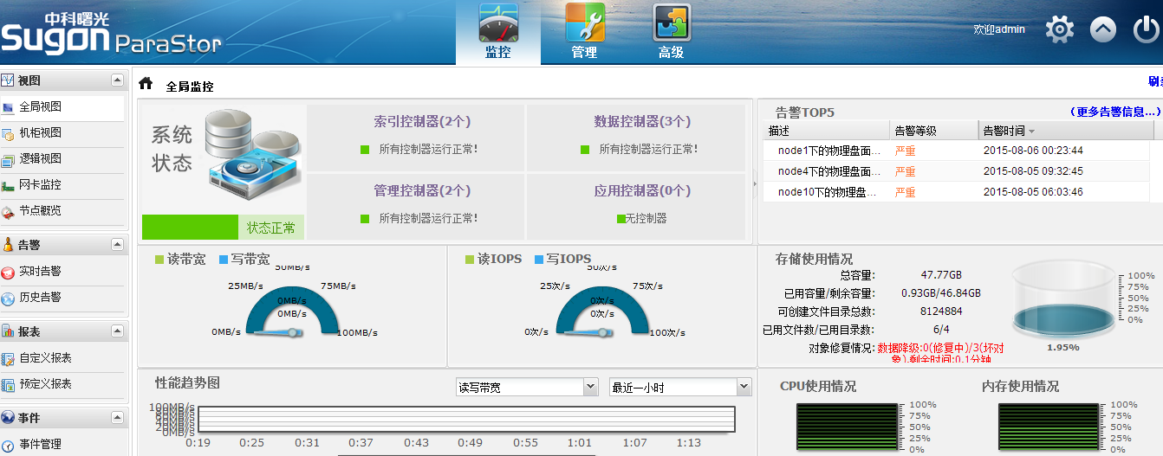
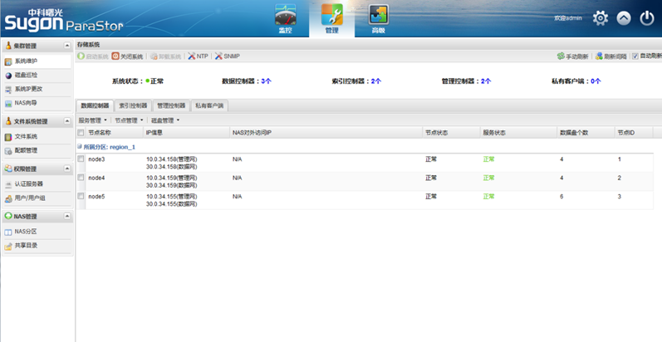
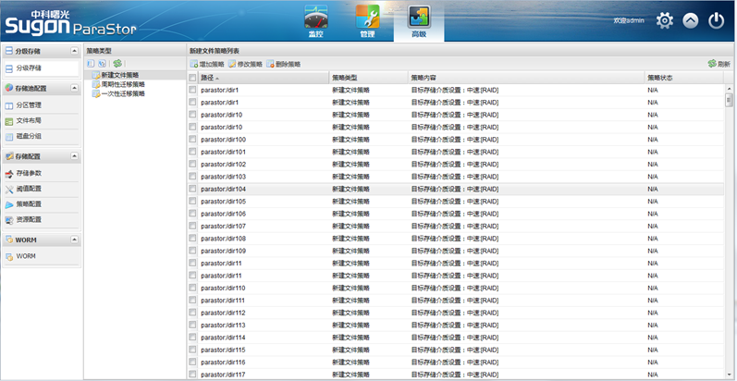
Unified Management, Easy Operation and Maintenance
ParaStor Cloud Storage Management System
Includes monitoring, managing, and advanced mode, simple and intuitive, unified management, intelligent monitoring, timely warning

Slide 29
Hierarchical Storage
Hot Data Area
FILE1
FILE2
FILE3
FILE4
Long Creation Time
Low Access Frequency
New File
Cold Data Area
High Access Frequency
FILE5
FILE6
Online storage area
High performance storage node
SSD/10K SAS
Node Classification
Node 1
SSD/10K SAS + SATA
Node to Node Classification
Node 2
SSD/10K SAS + SATA
Near/Off-line storage area
Big data storage node
SATA
Notes:
节点内和节点间分级

Slide 30


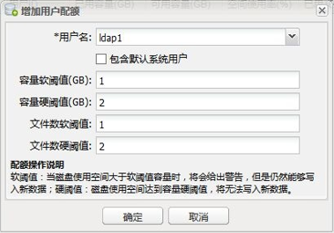


Quota Management
Multi-granularity and multi-hierarchy quota setting
300TB
Storage Pool
√
Based on file system
Based on catalog
Based on user group
Based on user
√
200TB
100TB
200TB
100TB
Group1
√
FS1
FS2
√
50TB
60TB
40TB
50TB
Group2
user1
user2
user3
user4
dir1
dir2
dir3
dir4
40TB
50TB
50TB
60TB
Threshold limit
√
Give warning
Can continue to write
File threshold limit
Capacity soft threshold
File number hard threshold
Capacity hard threshold
√
√
√
Unable to write
Notes:
软硬阈值限定
容量硬阈值

Slide 31


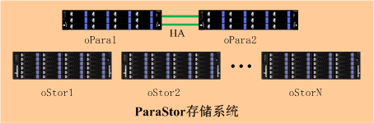
WORM
*
write
read
File set to WORM becomes
read-only
Client
WORM（Write Once Read Many）
Overall WORM clock, guarantees WORM time can not be affected or modified by hardware time
Supports manually placing written data in WORM state
Supports setting the time when written data are set to WORN state
Supports additional write operation to the content of the WORM file
Supports setting the expiration time of the WORM file
Supports WORN log, records WORN behaviors in the storage system

Slide 32
Small File Aggregation
Basic
Principles
Measured Performance
Suitable
Scenarios
Data recovery based on object implementation
Slow repair dealing with massive small file system
Aggregate several small files and repair the large file
Data recovery performance increases by 20 times after aggregation
Increased write performance
WORM scenarios
Massive small file system: Patent office, GIS, satellite remote sensing, biological gene, etc.

Slide 33



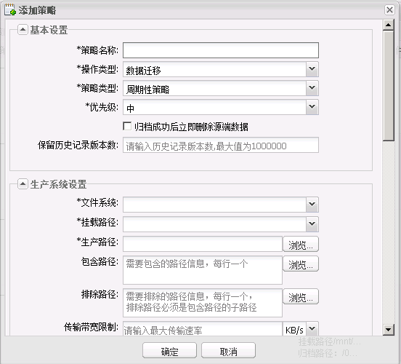
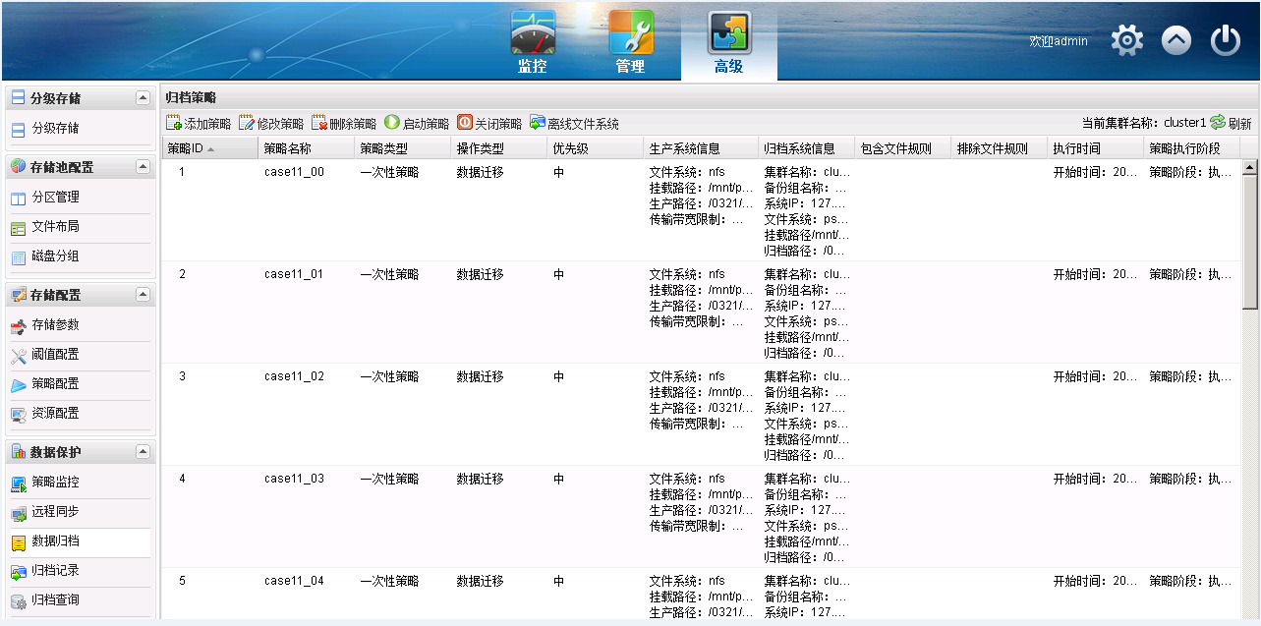

Data Archiving
Online storage for active data access only
Moving inactive, not commonly used data to near/offline storage, reduced cost and save for long term
Archiving system classification
  Tape library archiving
  Disk media archiving（ParaStor implementation）
  Disk library archiving
Active
data
Active
data
keep
Inactive
Data
Online storage
Archiving controller
Archiving and Long-term Storage
Long term
tape
tape
disk
produce system data
Near/Offline Storage
Strategy setting
Strategy setting
Archiving strategy
Archiving controller (2U12,binode symmetric system) or embedded into archiving system node
Origin system：supports NAS protocol
Archiving system：ParaStor storage
Application Scenarios
Framework
Manual or automatic execution
Supports file name, access time, file size etc.
Specific task priority and execution
Offline file retrieval
Strategy
Single node archiving/relocation performance（1.5GB/s）
Supports concurrent and breakpoint execution
Offline data inspection ensures data consistency
Reduces power consumption
Advantages
Petroleum Energy
Stellate remote sensing
Remote control
File index
Offline System
ParaStor
主存储
Notes:
磁带库是发展最早，使用最广泛的归档系统
光盘库新兴，技术相对来说不成熟

Slide 34


QoS（Quality of Service）
ParaStor Realization Function
Important tasks
Guarantees performance requirement for certain tasks
  Single stream/limit bandwidth
  IOPS and time delay
When Disk/Network/Node failure，service switching is limited to a certain time period
Multi-task (data stream) shared network
Suitable Scenarios
When network is overloading, several tasks have to wait or be discarded
Broadcast media and non-linear editing
  Multi-client stable bandwidth for read and write + smooth delay without frame lost
Remote control
  Stable bandwidth for continuous write operation
Critical or high real-time tasks could be interrupted
QoS provides better service for certain data stream(network), ensuring the consistency of important tasks

Slide 35


Automatic Power Control
Windows
UNIX/LINUX
Client
MAC
Data nodes are partitioned into active zone and sleep zone
Active zone provides read and write access
When active zone reaches capacity threshold, switch active zone
When active zone experience failure, switch active zone
Data to be accessed is located in the sleep zone, automatically switch to active zone
Sleep
Active
Active
Active
Sleep
Sleep
Significantly decreases system power consumption in offline storage applications like
video surveillance, satellite remote sensing, etc.

Slide 36
Catalog
1
Market Positions
2
Product Specifications
3
Product Features
4
Application Scenarios
5
Classic Cases

Slide 37







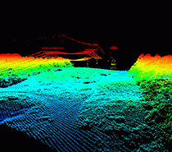


Classic Application Scenarios
High Performance Computing Life Sciences Digital Media Astronomy and Geography Documents
petroleum/earthquake gene/pharmacy non-linear/media information satellite/remote sensing Digital Library
meteorology/environment medical video surveillance mapping financial notes
Suitable for almost all scenarios with more than hundreds of TB of data
Medium and small internet storage support, aerospace design data storage, shared file library
Massive data archive back, replacing tape library
  Files, books, test data

Slide 38
Application Scenario: High Performance Computing
Excellent Performance
01
High efficiency kernel mode client IO
Storage bandwidth reaches hundreds GB/s
High Speed Communication Network
02
  Supports 56Gbps IB network optimization
  Supports 10Gbps、40Gbps network optimization
Active-Active Index Cluster
03
  Balancing metadata, fast processing of massive small files
Consistency of Client Cache
04
Embedded distributed lock mechanism
Completely consistent data for all clients at any time

Slide 39
Application Scenario: Cloud Computing and Virtualization
Small file optimization
01
Reduces unnecessary write penalty, improves virtualization application performance
Classification storage of cold hot data
02
Reduces the response time for key operations and access delay of the virtual machine
Dynamic online expansion
03
Linear improvement in performance, meets the need for further expansions
High reliability
04
No system hardware single point failure
Multiple copies and erasure code ensures the high reliability of data redundancy technology

Slide 40
Application Scenario: Satellite Remote Sensing
High Performance
01
High bandwidth and IOPS satisfies the high throughput requirements of satellite signal processing, and query system analyzing
Easy Expansion
02
Supports EB class storage space, coping with the increase in TB data
High Reliability
03
Multiple protection mechanism for components, nodes, and data
Hierarchical storage, data can be archived to offline system, for long-term preservation
04
Low Power Consumption
Energy saving strategy set according to partition
Automatic power control, reduces energy consumption by 30%

Slide 41
Application Scenario: Video Surveillance
Massive Space, Dynamic Expansion
01
EB class storage space, ensures massive high resolution videos and image concurrent storage
Excellent performance, linear growth
02
Massive images random retrieval, fast read and write
QoS ensures stable bandwidth, zero frame drop
03
Compatible with major manufacturers
Compatible with mainstream VVS platform and software
Seamless combination with NVR devices from major manufacturers
Cost Advantages, Energy Saving
04
Space utilization up to 80%
Automatic power control, reduces energy consumption by 30%

Slide 42
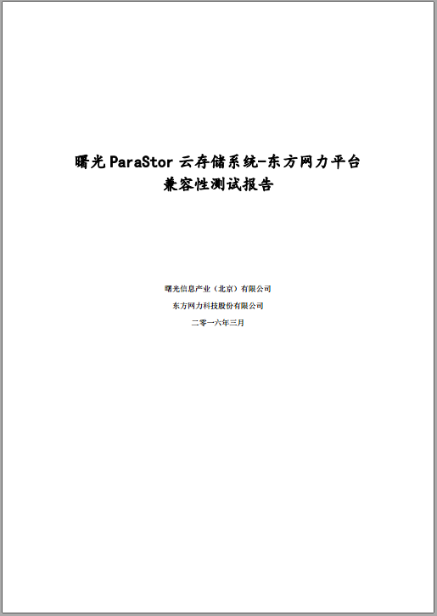
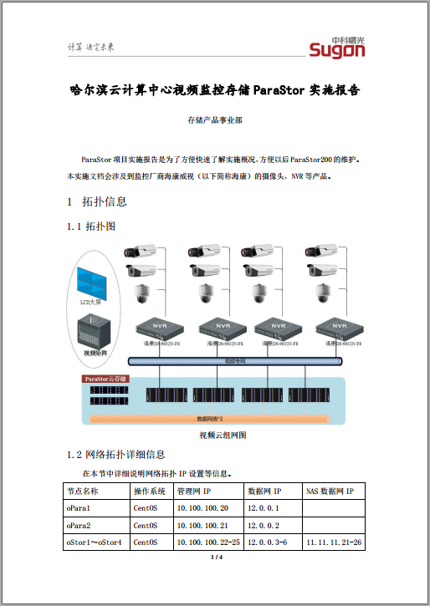
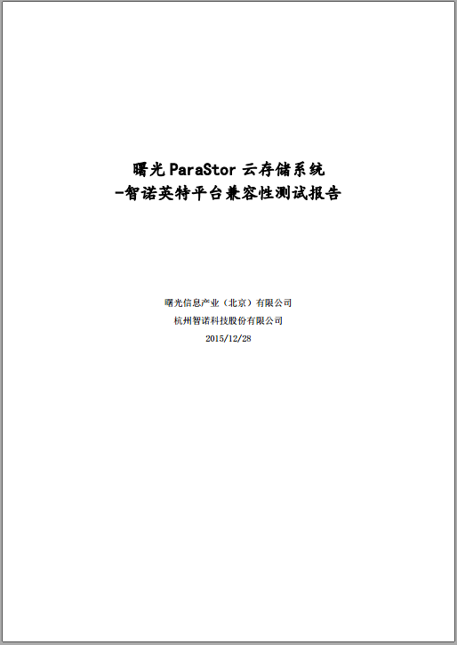
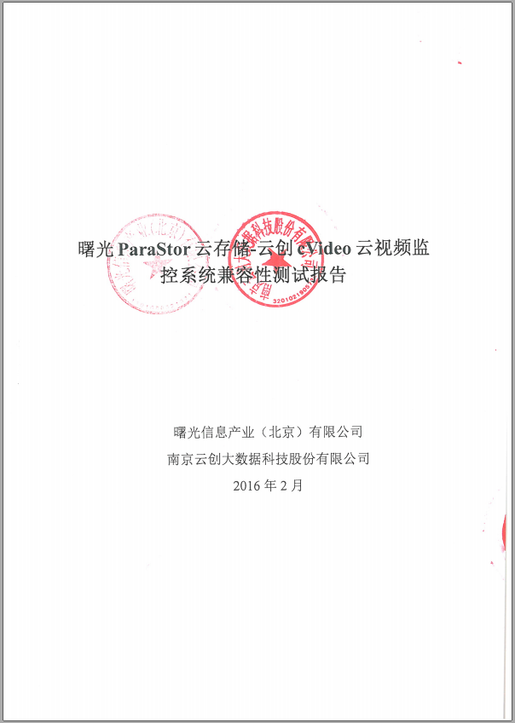

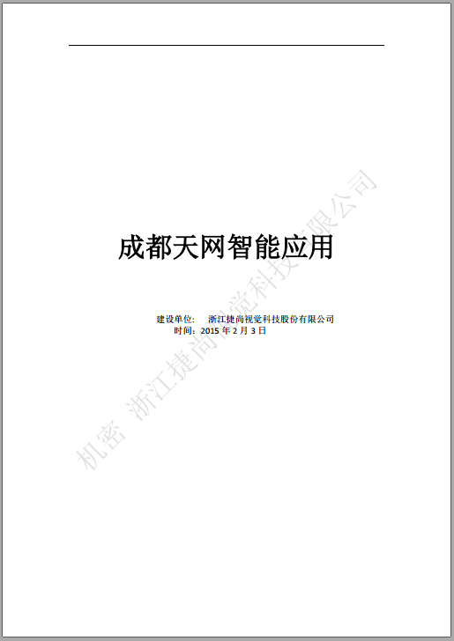
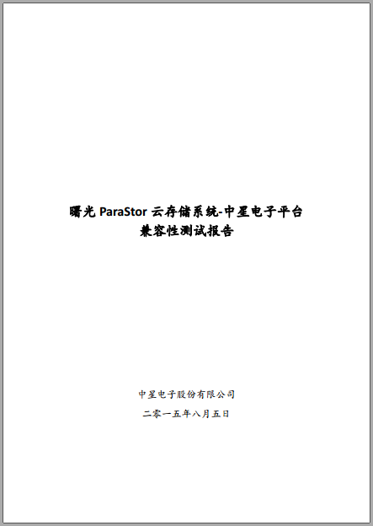
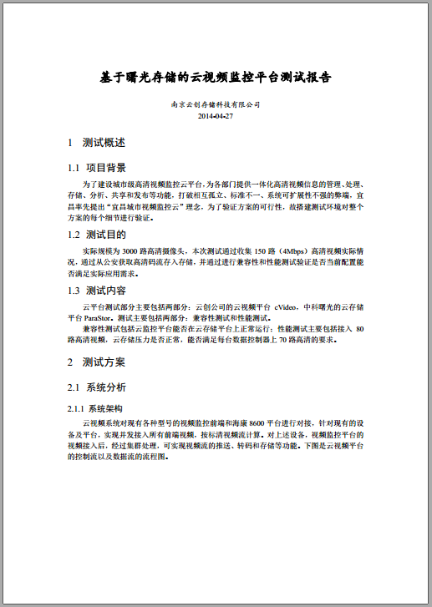
Video Surveillance Program Display
VSS manufacturers | Compatibility plan | Clients
海康 | 1、NVR docking 2、New management platform software supporting NAS protocol, currently under evaluation | 哈尔滨云计算中心 鹤壁市公安局
宇视 | NVR docking | 鹤壁市公安局
科达 | Management platform supports NAS protocol, directly mounting ParaStor storage system Video service and storage an be integrated or separated | 抚州云计算中心
东方网力 |  | 抚州云计算中心
云创 |  | 宜昌市政府 潍坊云计算中心
天地伟业 |  | 天津市北辰区人民政府
智诺英特 |  | 某平安城市项目运作中
捷尚 | Upper layer service, provides smart software | 成都天网
NVR + Cloud Storage
Service and Storage Separation
Service and Storage Integration
Mount to NVR device, as NVR storage space
Small to medium size, clients approve NVR, traditional VSS manufacturers like 海康、宇视、大华 have a greater say in the project
Leading users to abandon the useless NVR backup program
ParaStor only serves as storage resource pool
Video service is deployed on a separate server
Low cost hardware can be used
Ostor Node embedded video service software
Directly install on Linux version, install KVM virtual machine before installing Windows version
No need for video service server, integration program has more advantages

Slide 43
Application Scenario: Broadcasting Medias
Unified Data Storage and Sharing
Scale-out Horizontal Expansion
01
02
Multiple workstations can edit the same media file
Linear expansion for storage capacity and expansion, support HD to Ultra HD transition
QoS
Continuous reliable assurance
03
04
Provide fast and stable data storage, search and share access service
Cluster architecture and data redundancy protection mechanism, ensuring uninterrupted service 24/7

Slide 44
Catalog
1
Market Positions
2
Product Specifications
3
Product Features
4
Application Scenarios
5
Classic Cases

Slide 45
































Classic Cases
Traditional
HPC
Cloud Computing
Meteorology Environment
Digital Media
Video Surveillance
Satellite Sensing

Slide 46

Classic Case: Shenzhen Super Computer Center
Application Scenario：HPC
Scientific computing, bio-genetic, engineering computing, etc.
Shenzhen cloud computing center: total investment of 1.23 billion yuan, total construction area of 43 thousand square meters. It’s computing speed reaches 1.271 million billion times/second, ranking 2nd fastest in the world
It is the most advanced high performance computing research development center in Asia
Back-ground
Scale
Storage capacity of 16 PB
Stably running for 4 years
Profit
Meets the need for dynamic, high performance storage resource from clients in southeast area
Unified management
中科院计算所研制
曙光公司制造
Notes:
，总投资12.3亿元，一期建设用地面积1.2万平方米，总建筑面积4.3万平方米。主机系统由中国科学院计算技术研究所研制、曙光信息产业（北京）有限公司制造，2010年5月经世界超级计算机组织实测确认，运算速度达每秒1271万亿次，排名世界第二，该项目是国家863计划、广东省和深圳市重大项目。
国家超级计算深圳中心（深圳云计算中心）系深圳市人民政府批准成立的企业化管理事业单位，下设：系统运行部、研究开发部、高性能计算室、市场拓展部、行政管理部（第二市场拓展部）、网络安全室，专业技术和管理人员90%具有硕士或博士学位，多数具有海外留学经历，预计2012年将建成拥有上百高端人才的科技创新平台。
国家超级计算深圳中心（深圳云计算中心）立足深圳、面向全国、服务华南、港、澳、台及东南亚地区，将承担各种大规模科学计算和工程计算任务，同时以其强大的数据处理和存储能力为社会提供云计算服务，将建成功能齐全、平台丰富、高效节能、国际一流的高性能计算研究开发中心和云计算服务中心。
满足华南高性能计算用户动态多变、高性能的存储资源需求
为每位深圳市民配置200GB云盘空间
深圳智能交通流量控制系统

Slide 47
Classic Scenario: Aerospace Institute
Back-ground
Application Scenario: Satellite remote sensing
Satellite remote sensing data collection and testing system
Scale
5 sets in 2014, 1 set in 2015
Total volume of 350TB
Profit
Meets the demand for continuous high access bandwidth
Guarantees the process of general testing platform in research program

Slide 48
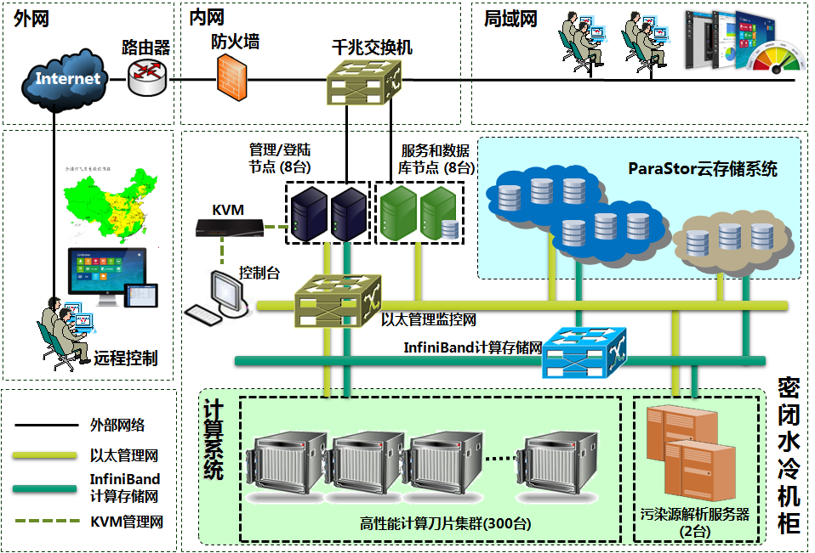
Classic Case: China National Environmental Monitoring Centre
Back-ground
High performance application
Air quality prediction and warning
Pollution source analysis
Scale
Storage capacity over 3PB
Meets the need of storing long-term environmental data, numerical model of large scale parallel IO
Profit
Weather forecast ability for the next 7 days
Supports environmental emergency response

Slide 49
Appendix 1 – Symmetric and Asymmetric Architecture
Asymmetric Architecture
More adaptive, better performance for small file scenarios
Less expense for metadata consistency, better expansion ability
Metadata and data are stored in separate nodes
Symmetric Architecture
Less cost for medium and small scales
Same protection level for metadata and data
Metadata is dispersed and stored in data nodes

Slide 50
Appendix 2-Major Manufacturer Competitive Power 1
 | Sugon Parastor | Huawei OceanStor 9000 | EMC Isilon
System Architecture | Asymmetric | Symmetric | Symmetric
Expandability | 4096 data nodes maximum | 288 data nodes maximum | 144 data nodes maximum
Data Node Configuration | 2U24/4U36/4U36/5U86 | 2U25/4U36/4U36 | 2U12/4U24/4U36
Access Mode | POSIX/NFS/CIFS/HDFS | NFS/CIFS/HDFS | NFS/CIFS/HDFS
Data Protection Mode | N+M | N+M | N+M
Advanced Mode | Data archiving, Oos, automatic power control, hierarchical storage, directory quota, remote duplication | Hierarchical storage, directory quota, remote duplication, snapshot | Hierarchical storage, directory quota, remote duplication, snapshot, data reduplication
Notes:
盘位？

Slide 51
Appendix 3-Major Manufacturer Competitive Power 2
type | File systems | Advantages of ParaStor
Open source | HDFS, Lustre, Ceph、MooseFS, Gluster, etc. | Complete independently developed software Hardware and software integration, dynamic and flexible configuration Performance optimization can be done for different hardware
Commercial | EMC Islion | Similar specification, price advantage Advantages in high performance computing programs and performance Better industry coverage, diverse large-scale cases
 | IBM GPFS | Supports node failure, more reliable Distributed metadata, better performance Hardware cost advantages
 | 华为N9000 | Separate architecture for metadata and data, more advanced metadata performance More advantages in high performance computing projects and performance
 | 蓝鲸 BWStor | Supports node failure, high reliability Supports hierarchical storage, quota, WORM and other advanced features
 | LoongStor | Integration of software and hardware, overall cost advantages Higher data redundancy, more reliable Supports cluster NAS

Slide 52
Appendix 4 – Financial Note Market
Market size: take agricultural credit as an example, market size of 28 million
Integrators：银之杰、中科金财、上海捷奥，信雅达，江苏尚博、鑫万佳
Customer group：banking, insurance, social security industries
Big client distribution：City commercial banks, 城商行, agricultural credit, foreign banks, joint-stock firms
Procurement model:
  Provincial shortlisted test, independent bidding in cities
  Centralized purchase for provinces, distribute to cities
  Storage usage pattern:
  Centralization for provincial banks
  Decentralized deployment in cities and countries
Competitors and products：
  EMC：centera
  夏尔科技：iCas
  Huawei：none（使用SAN存储与信雅达捆绑）
Market advantages for ParaStor binode storage system

Slide 53



Appendix 5- Configuration Direction for Common Scenarios
Cloud Computing and Virtualization
Classification storage, SSD/10K SAS storage virtual machine image file; SATA storage user data
Recommend double copy as data redundancy
Video Surveillance
Ostor Node should have memory of at least 128GB
Recommend using 4U36, 6T disks, do not recommend using monitor disks
Consider using 5U86 for projects larger than 5PB
Satellite Remote Sensing
Configure at least 128GB for the memory of Ostor Node
Recommend 5U86 for massive offline storage system

Slide 54
Appendix 6 – System Configuration Guide
Network Type
Depends on the type and quantity of the client’s data network, cluster NAS configuration typically needs single
MGR、Opara、Ostor node configuration is consistent with data network type
Ostor contains 2U24、4U24、4U36、5U86 hardware configurations, able to configure disks with different capacities
Quantity is determined by storage capacity, space utilization, hardware specification, hardware type, etc.
Data Controller
Quantity and configuration depends on the quantity of files in the system
Estimate the number of files and directories according to storage capacity and the file size of application scenarios
Estimate required special capacity for metadata according to the file/directory number and the size of the file/directory metadata directory (1k for each file, 5k for each directory)
Determine the number of index controller according to metadata special capacity and the metadata space provided by one set of index controller(480GB, 960GB, 1.6TB and 2.4TB)
Index Controller
When the number of index controller + data controller is smaller or equal to 12, no need to configure management controller, otherwise, configure 2 sets of management controller
Management Controller

